Slide 1

Introduction to Digital Systems: Chapter 4: Description and analysis of Gate Networks
Puneet Kumar Jain
CSE Department
The LNM Institute of Information Technology
Reference book: Introduction to digital systems, Ercegovac, Lang, Moreno

Slide 5
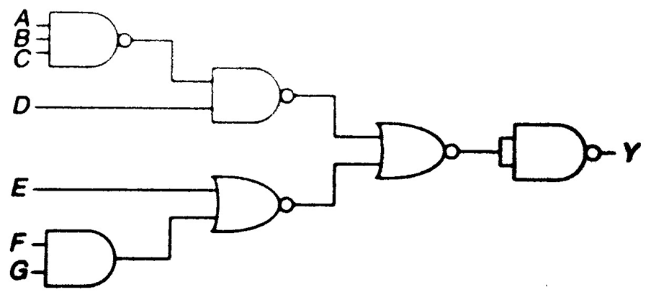
Exercise

Slide 6

End of chapter 4

